Slide 1


Project b

Slide 2
Wat wij al hebben gedaan
Persona
The main protagonist
The story line
The game
Basis code
Trello
One-Page

Slide 3
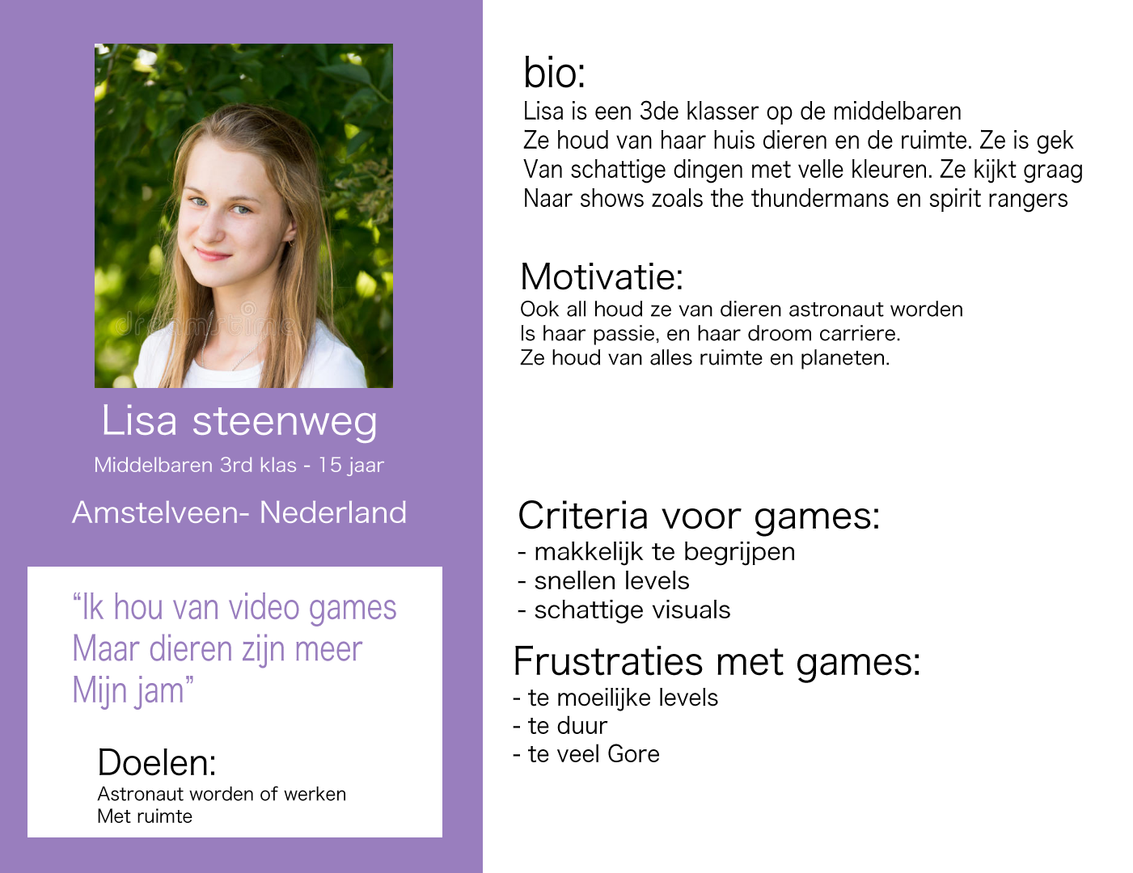
Persona

Slide 4
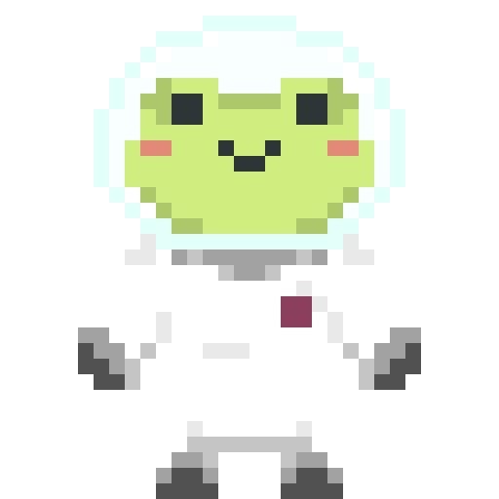
Meet Agent f
This little guy is an astronaut whose ship crashed. You will be playing as him and help him with “Project B”. Project B, also known as Project Back Home entails collecting parts of his ship so he can fix his ship and go back to his home planet. The problem? They’re all scattered around multiple planets with unknown entities. Collect them all and send agent F home.

Slide 5
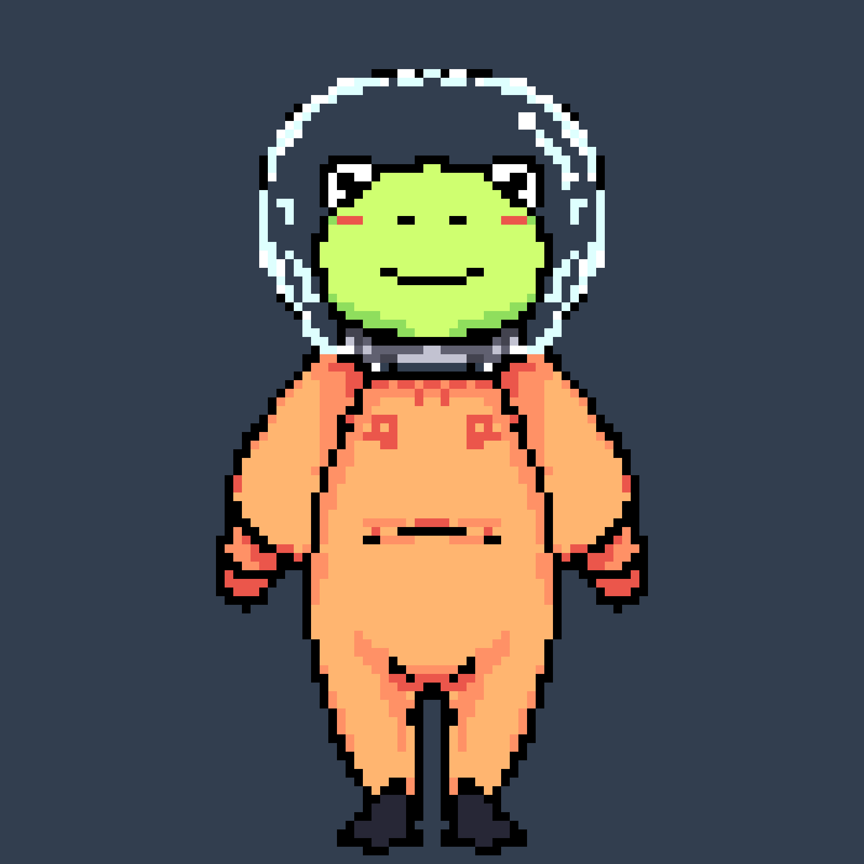
Game?
2D
Platformer
Movement
(Dubble) Dash
(Dubble) jump
Enemies
Pixelart

Slide 6
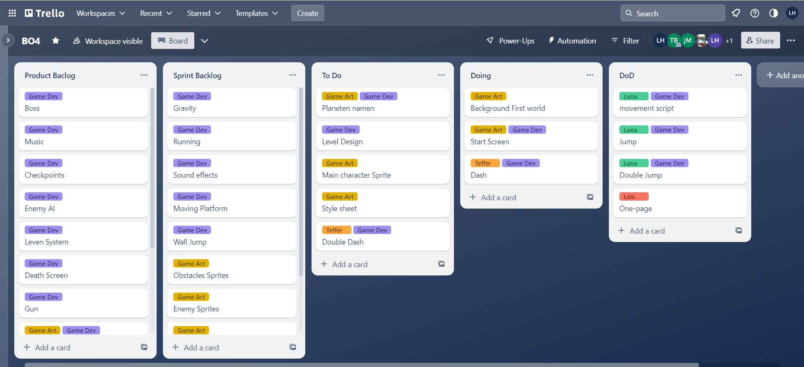
Trello

Slide 7
One-page

Slide 8
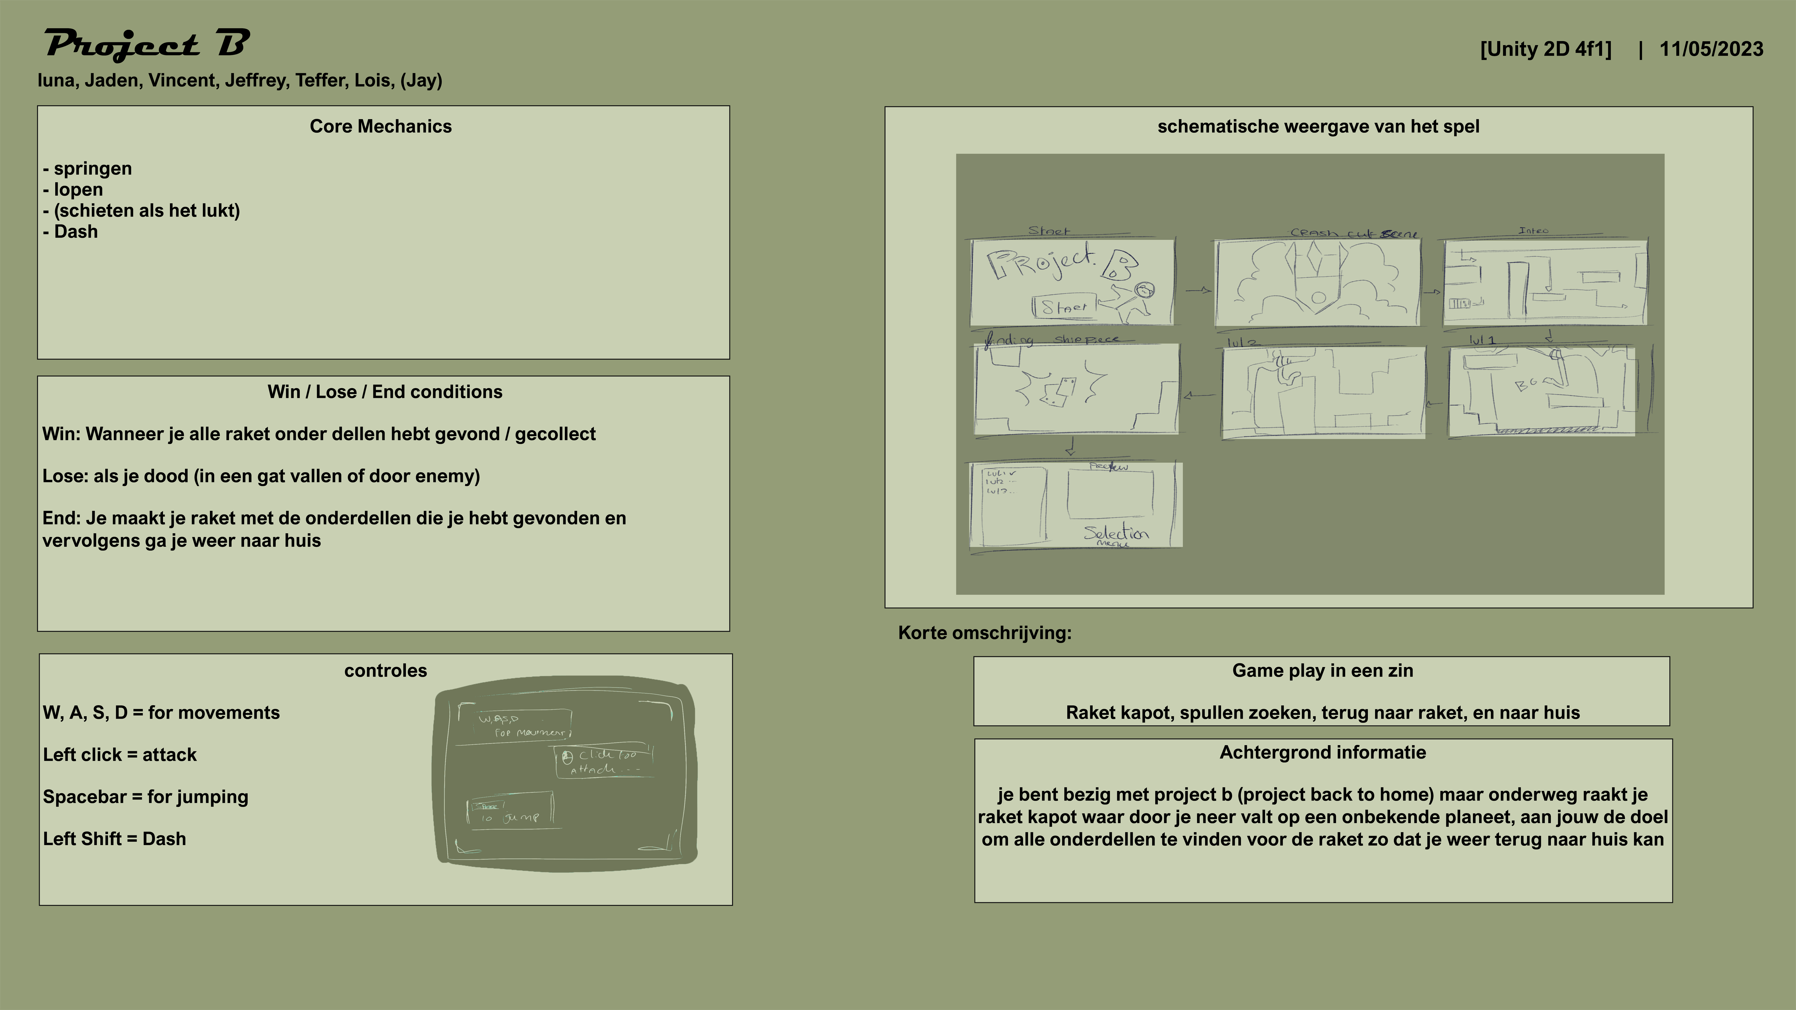

Slide 9
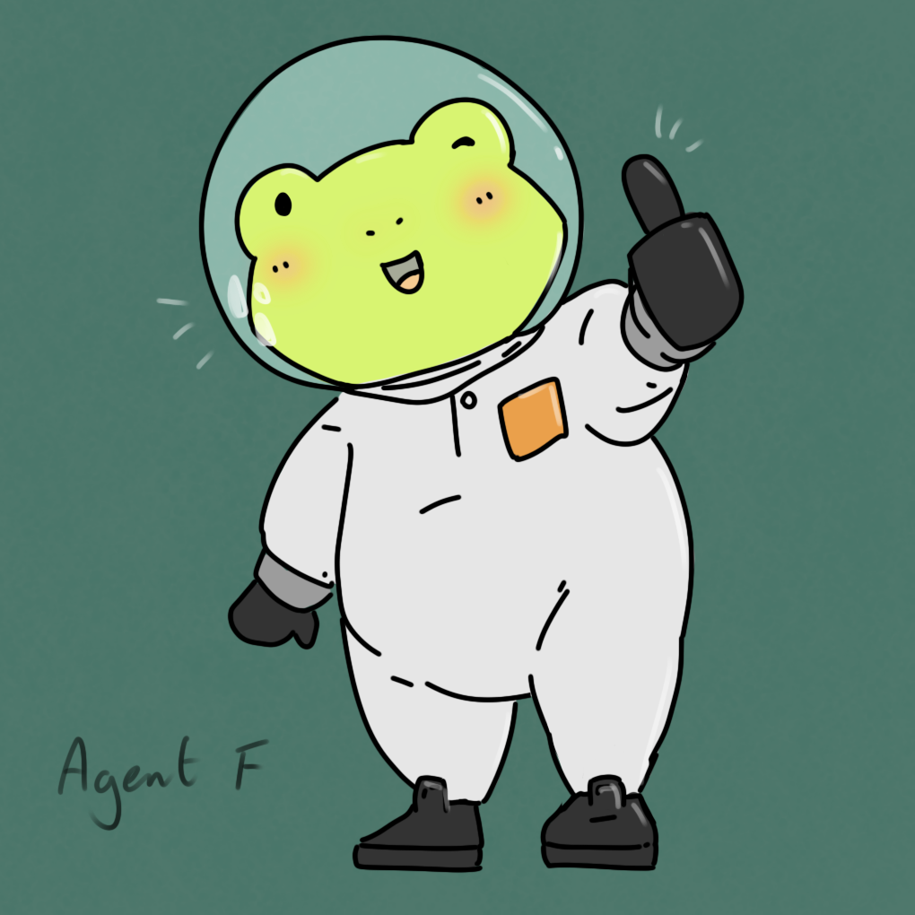
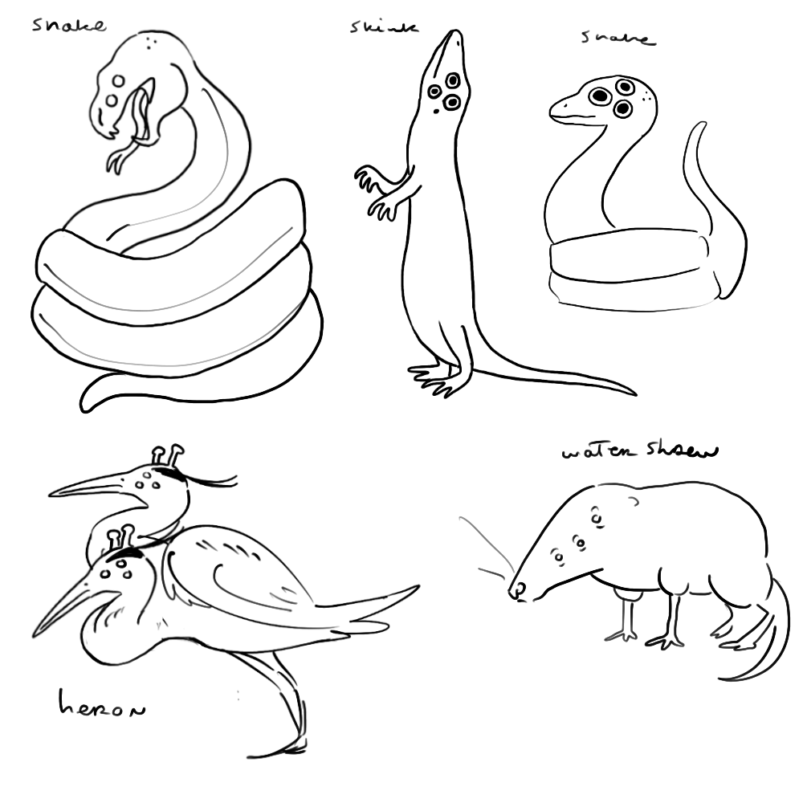
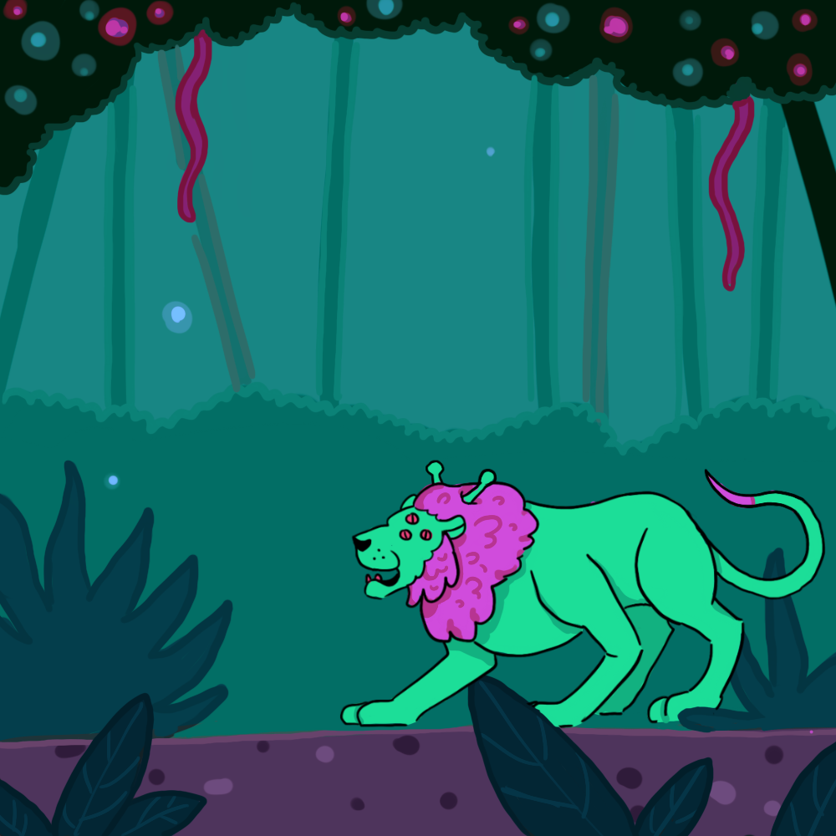
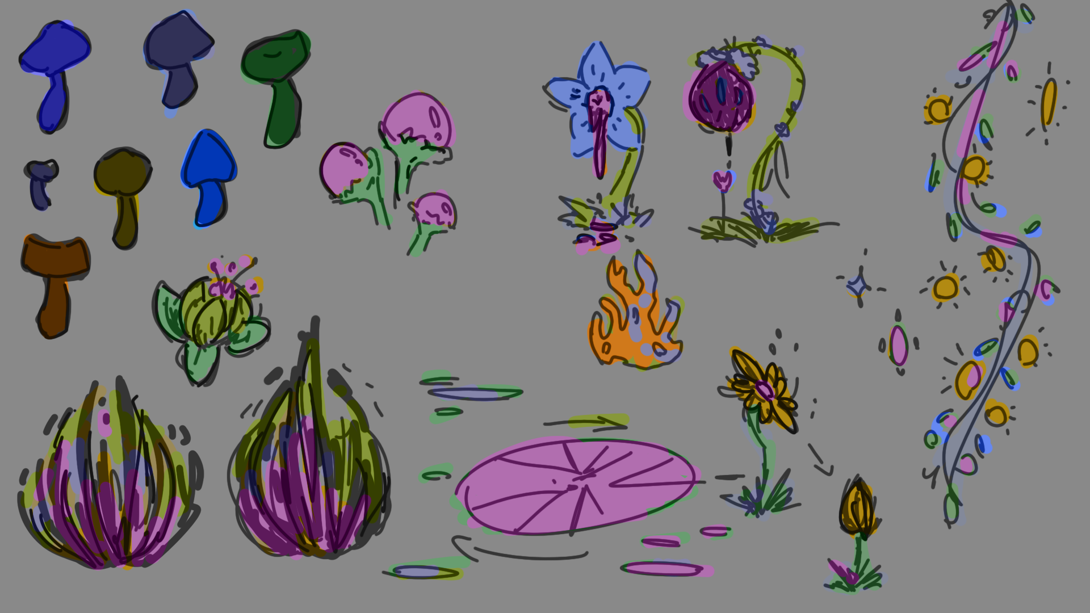
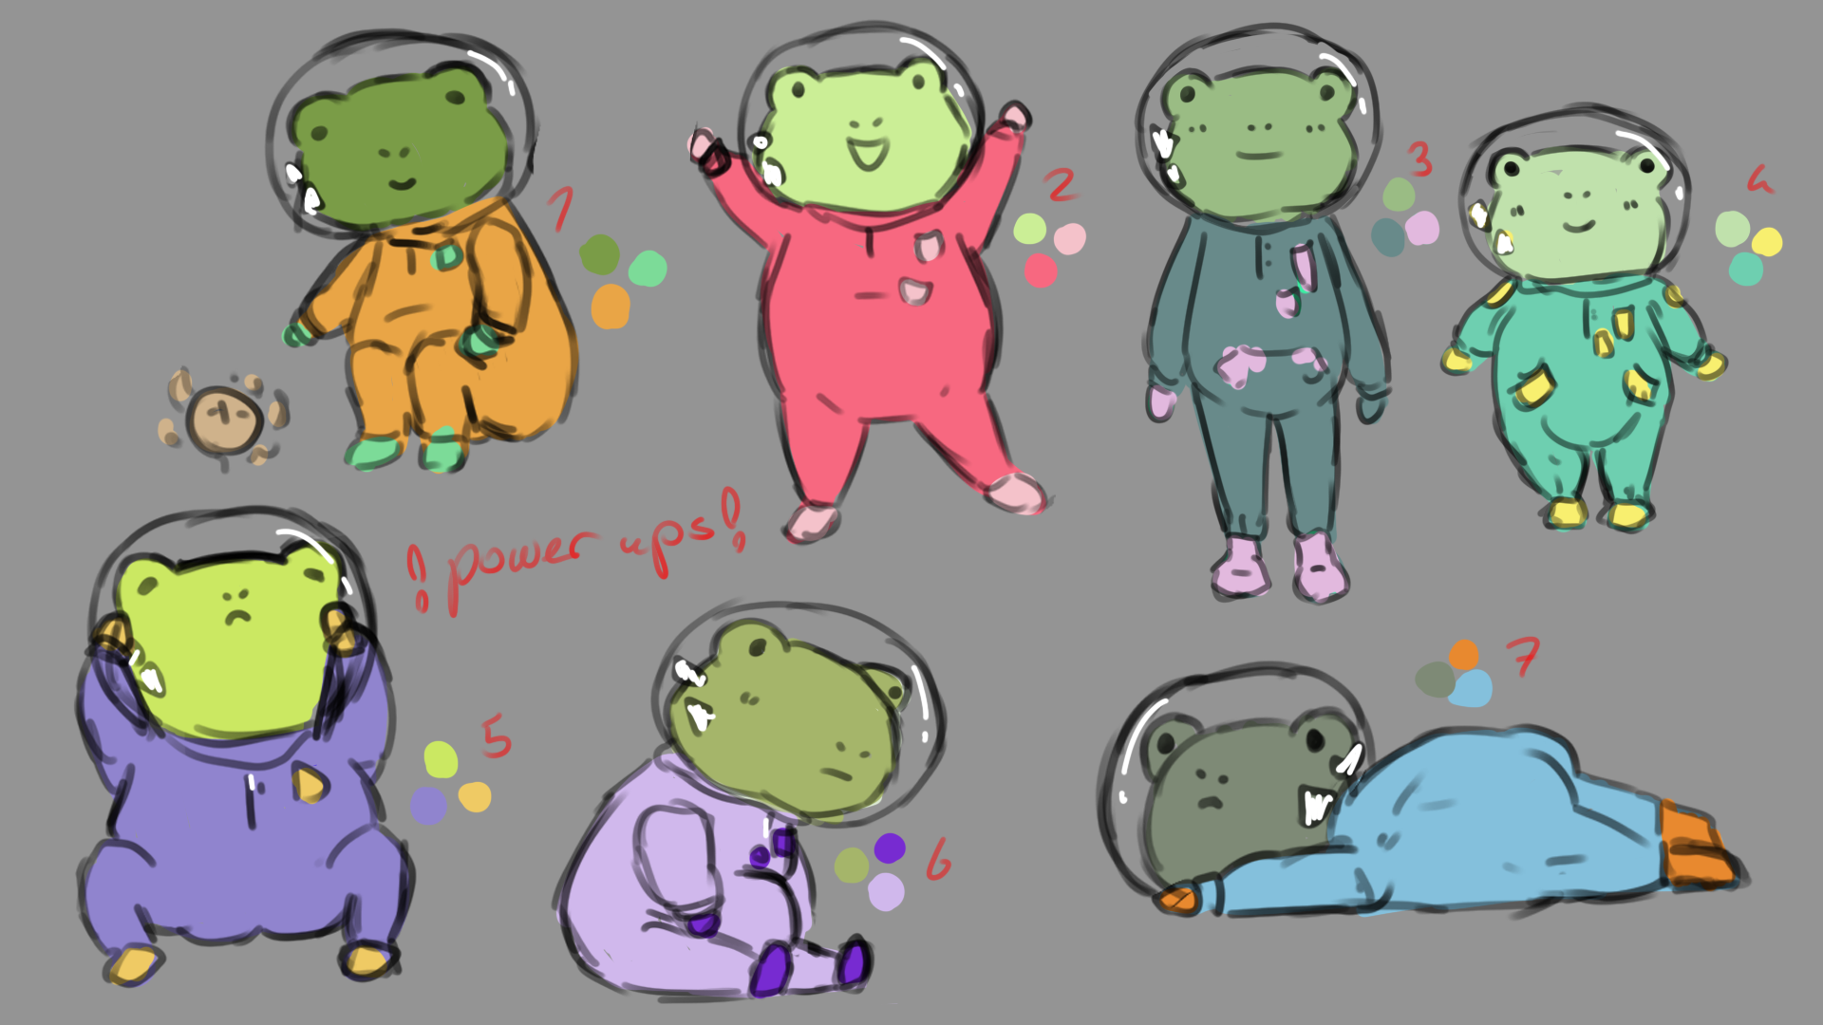
Schetsen

Slide 10
Project b
Jaden
Lois
Vincent
Jeffrey
Luna
Teffer
(Jay)

